Slide 1

placement prediction
GROUP MEMBERS: RIDDHESH DEVGHARE
AMIT PARMAR MAHESH MALI
KAUSTUBH MOHITE OMKAR MAYEKAR
MENTOR: DR. S. P. GITE

Slide 2
Problem statement:
The Placement of students is one of the most important objective of an educational institution. Reputation and yearly admissions of an institution invariably depend on the placements it provides it students with. That is why all the institutions, strive to strengthen their placement department so as to improve their institution on a whole. Any assistance in this particular area will have a positive impact on an institution’s ability to place its students. This will always be helpful to both the students, as well as the institution.

Slide 3
Objective :
To study & predict the recruitment of a candidate in placements based on the available factors in the dataset.
To study the relationship between Internships with chances of getting placement .

Slide 4
APPROACH:
The classical machine learning tasks like Data Exploration, Data Cleaning ,Feature Engineering, Model Building and Model Testing. We will try out different machine learning algorithms that’s best fit for the above case.

Slide 5
TYPE OF DATA :
Primary data collection method is used.
The dataset consists of Placement data of students from colleges all over Mumbai.
It includes secondary and higher secondary school percentage and specialization. It also includes degree specialization, type and Work experience and salary offers to the placed students.

Slide 6
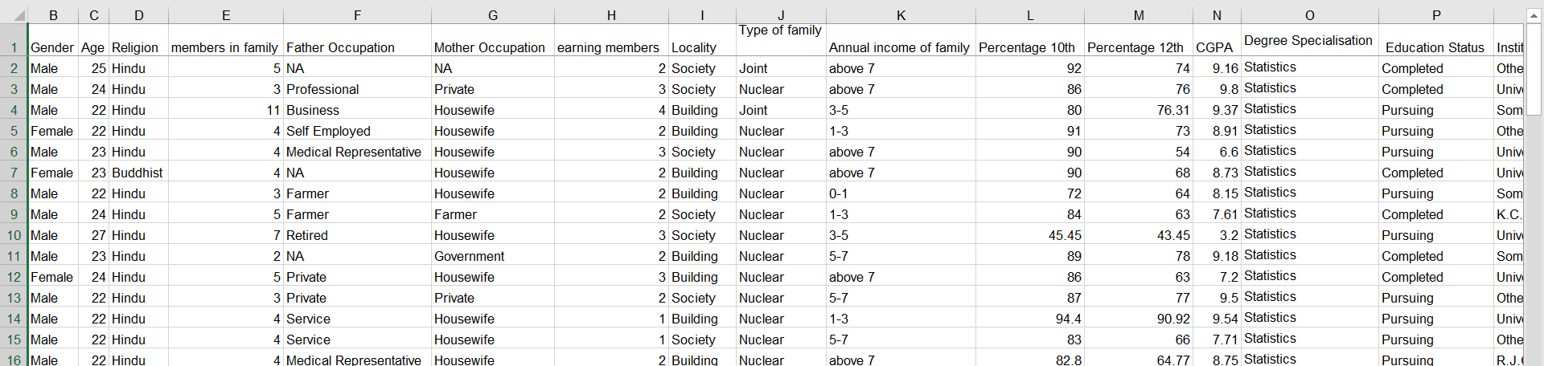
Data Collection:-
The sample data was collected by survey conducted on the students from different campus and fields regarding placements through questionnaire. The following image represents the data obtained after the survey.
Till now 174 observations have been collected

Slide 7
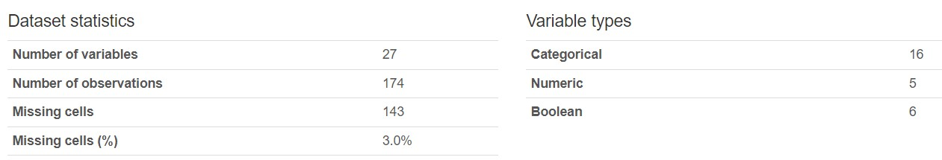
Variables:-
Gender
Age
Religion
Members in family
Father’s occupation
Mother’s occupation
Earning members in family
Type of family
Locality
Annual income of family
Percentage obtained in 10th
Percentage obtained in 12th
Degree CGPA
Degree Specialization
Education status
Institute
Extracurricular activities
Technical/non-technical events
Communication skills
Problem solving skills
Leadership/Teamwork skills
Work experience
Internship
Placed in the campus
Placed off-campus

Slide 8
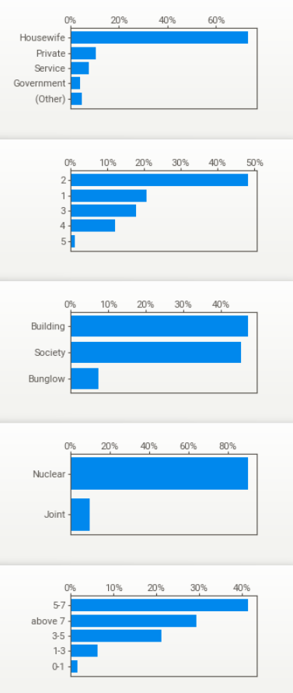
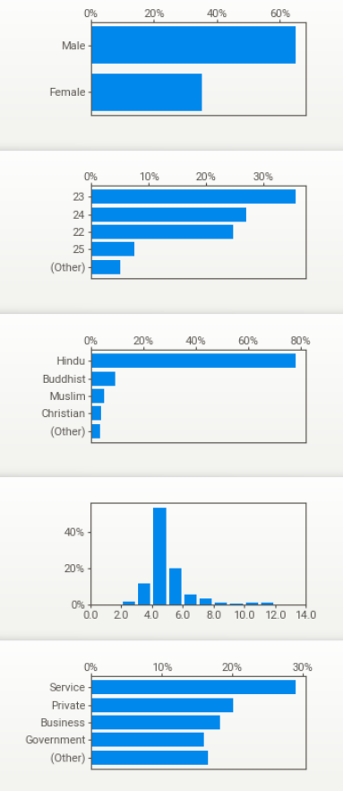
Exploratory data analysis(EDA):-
Mother Occupation
Gender
Age
Earning members
Religion
Locality
Members in family
Type of family
Father Occupation
Annual income of family

Slide 9
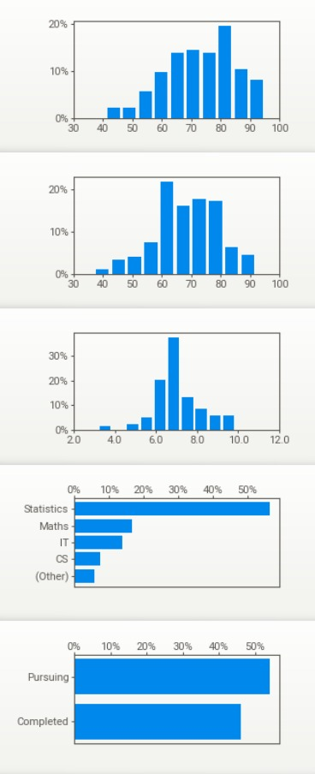
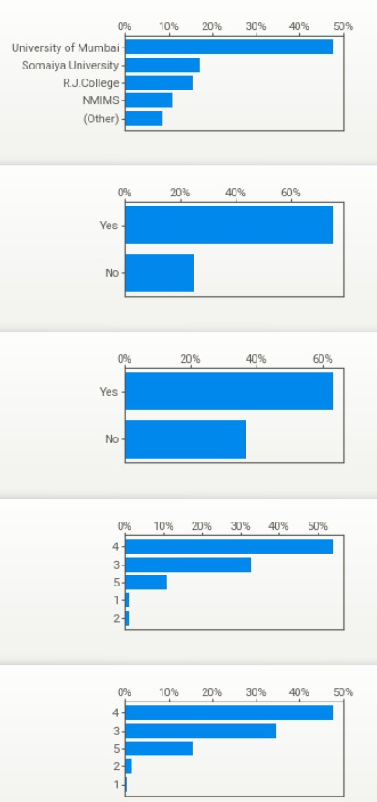
Percentage In 10th
Institute
Percentage In 12th
Extracurricular activities
CGPA
Technical/non technical events
Degree Specialisation
Communication skills
Education Status
Problem solving

Slide 10
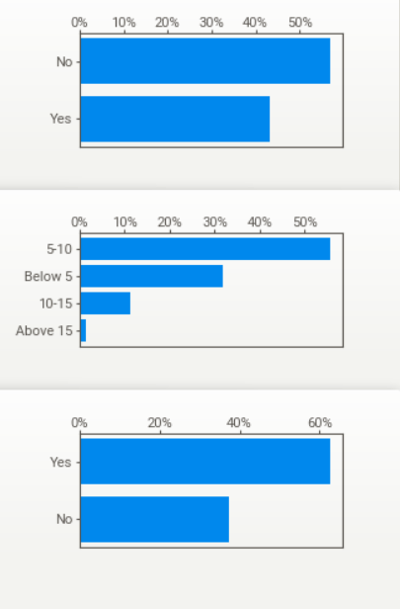
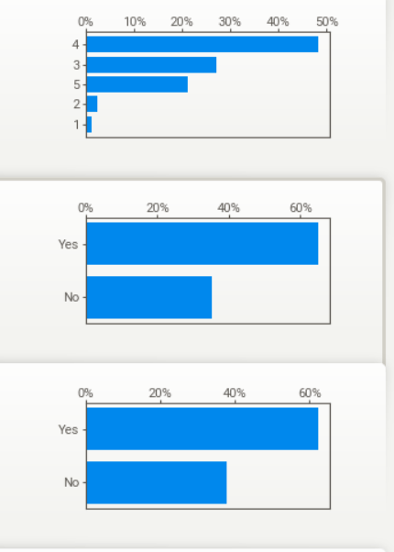
Work experience
Leadership
Placed in the campus
On campus/off campus annual pay
Placed off campus
Internships

Slide 11
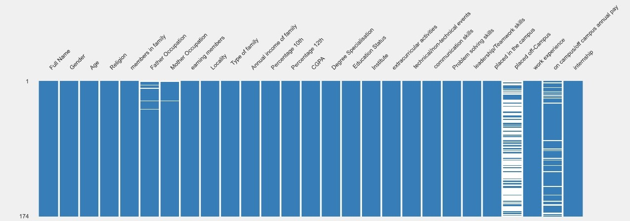
Missing values:-
Insight :-
Nullity matrix is a data-dense display which lets you quickly visually pick out patterns in data completion.
INSIGHTS :-
Father Occupation has 5 (2.9%) missing values
Mother Occupation has 2 (1.1%) missing values
Placed off-Campus has 113 (64.9%) missing values
On campus/off campus annual pay has 23 (13.2%)

Slide 12
Handling missing values:-
Missing values have been found in columns:-
Father’s Occupation - 05
Mother’s Occupation - 02
Placed off campus -115
Salary - 40
The missing values in the column Father’s Occupation & Mother’s Occupation been assigned a new category named ‘Others/Unknown’.
Missing values in salary variable is being replaced by mode value of the respective column.
Missing values in Placed off campus has been occurred due to design flaws.

Slide 13
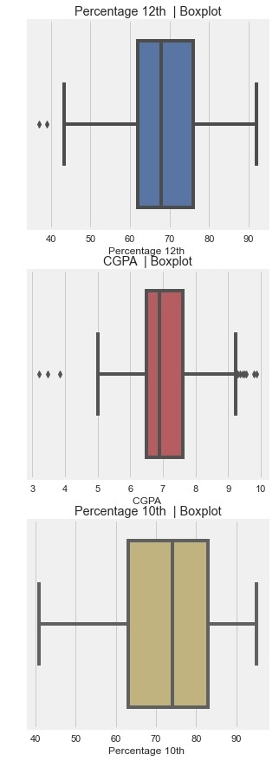
Detection of outliers :-
In statistics, outliers are data points that fall far outside the range of the other data points in a dataset. Outliers can be caused by measurement errors, natural variations in the data, or rare events that do not fit the typical pattern of the data.
Insights:-
From the Boxplots we can see that outliers are detected in the variables percentage 12th and CGPA in degree.
No outliers are detected in the last figure i.e Percentage in 10th

Slide 14
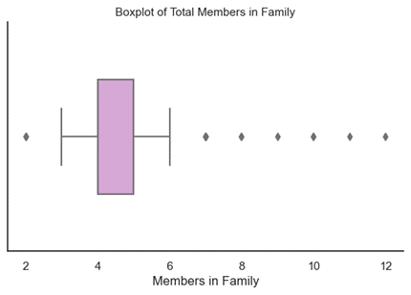
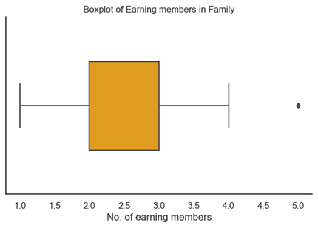
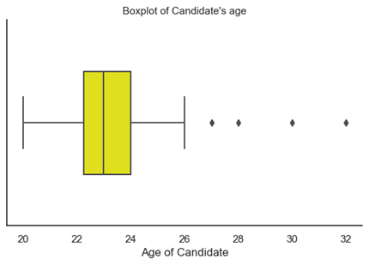
Insights :-
Outliers are detected in all Three figures representating Total Members in family , Earning members in Family & Candidates Age.
Discuss the potential causes of the outliers: Outliers may be caused by measurement errors, data entry mistakes, or genuine anomalies in the data. It's important to explore the possible causes to determine if the outliers are valid or if they should be removed.
Depending on the nature of the outliers, there are several options for handling them. These may include removing them from the dataset, transforming the data to reduce the impact of outliers, or analyzing the outliers separately from the main dataset.

Slide 15
Handling Outliers:-
Outliers been observed in following Variables :-
Percentage 12th
CGPA
Members in Family
Earning members in family
Candidate’s age
Replacing outliers using Tukey's fences method :-
Outliers greater than Q3 + 1.5 * IQR with Q3 + 1.5 * IQR, and outliers lower than Q1 - 1.5 * IQR with Q1 - 1.5 * IQR. This approach is also known as capping the outliers.

Slide 16
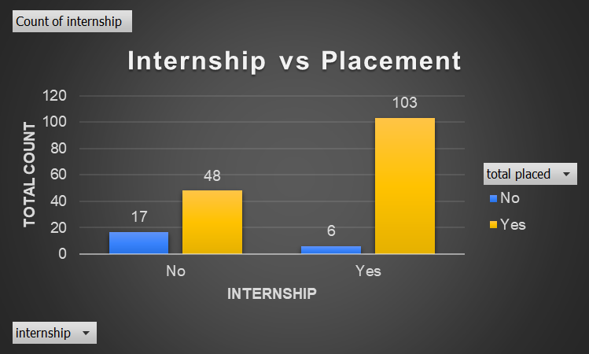
Relationship between Internship & placement:-
INSIGTHS:-
The graph suggests that students who complete internships have a higher chance of getting selected by companies for job placements. This is because internships provide students with hands-on, practical experience in their chosen field, which is highly valued by companies.
Completing an internship can help students develop relevant skills, build professional networks, and gain a better understanding of their career interests and goals.
Therefore, students who complete internships have a better chance of securing job placements and kickstarting their careers on a positive note.

Slide 17
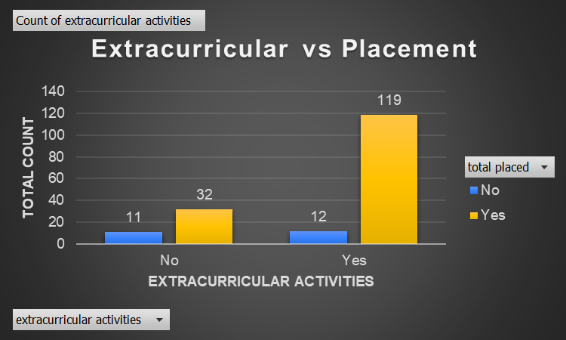
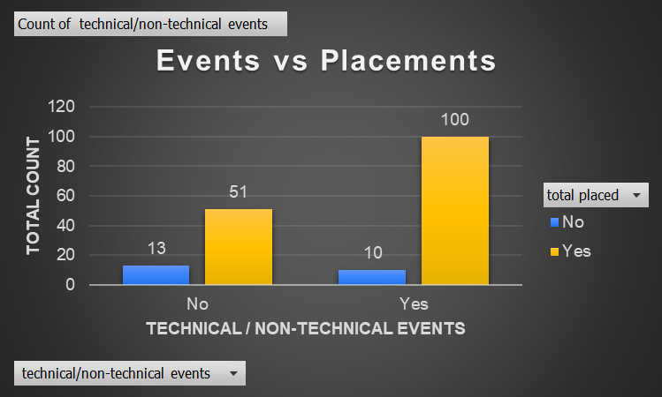
Relationship between Extracurricular activities & placements :-
INSIGHTS:-
The graphs suggests that students who are involved in extracurricular activities as well as events have a better chance of getting selected by companies for job placements. This is because companies tend to value not only academic qualifications, but also the skills and experiences that students gain through their participation in extracurricular activities.
Therefore, students who engage in extracurricular activities tend to have an edge over those who do not when it comes to job placement.
Overall, the graph highlights the importance of extracurricular activities in shaping the overall profile of a student and enhancing their employability.

Slide 18
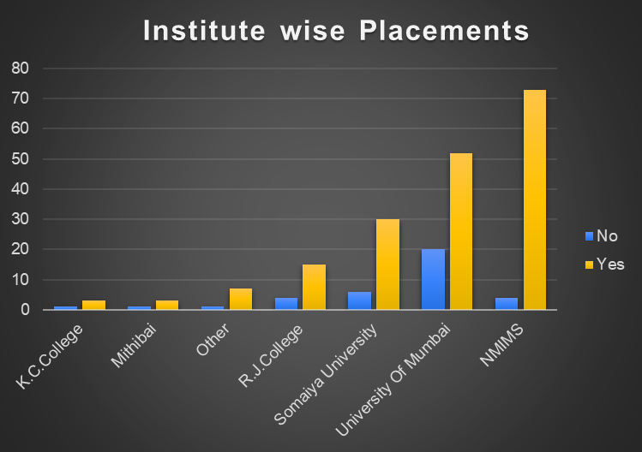
Placements of different institutes:-
Insights:-
Institute wise placement graph is useful for students who are considering different institutes for their higher education. By looking at the placement statistics, students can get an idea of the institute's reputation in the job market & various other aspects.
NMIMS has the highest placement rate followed by the University of Mumbai and others respectively.

Slide 19
Testing the Hypothesis:-
We want to study the relationship between Internships with chances of getting placed . We are going to
conduct Chi-squared test to test the significance of the variable "internship" on the target variable
"placed" which has two outputs ("yes" and "no"). Our hypothesis are :-
H0 : There is no association between the variables internship and placed v/s
H1 : Both the variables are associated
The output from Chi-square test we got is :-
Therefore we reject H0 against H1 stating that the variable ‘internship’ and target variable ‘placed’ are
associated.
Chi-square test statistic | Degrees of freedom | p-value
13.388794574376664 | 01 | 0.0125313

Slide 20
Checking normality :-
When examining the normality of a dataset, one important characteristic to consider is symmetry. A symmetric distribution is evenly balanced around its central point. In the case of a normal distribution, it exhibits perfect symmetry. Here are a few examples of graphs depicting symmetric normality:
1. Histogram with a Bell Curve:
A common way to represent normality is through a histogram overlaid with a smooth curve representing the idealized normal distribution. In a symmetric normal distribution, the histogram bars are evenly distributed around the center, and the curve aligns with the shape of the bars.
2. Q-Q Plot (Quantile-Quantile Plot):
A Q-Q plot compares the quantiles of a dataset against the quantiles of a theoretical normal distribution. In a symmetric normal distribution, the points in the Q-Q plot will roughly fall along a straight line.

Slide 21
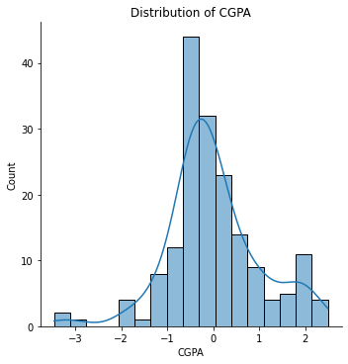
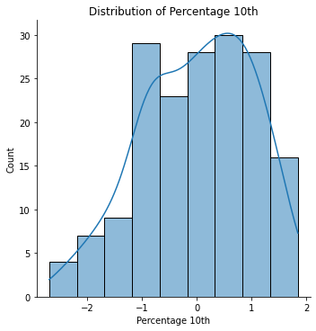
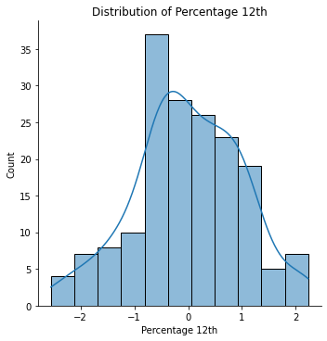
checking normality using histogram

Slide 22
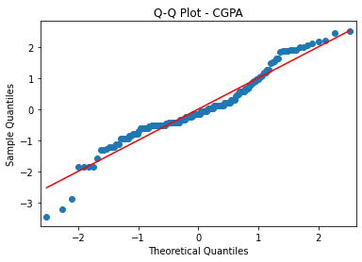
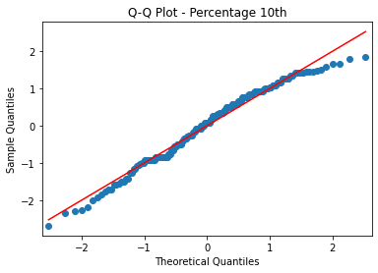
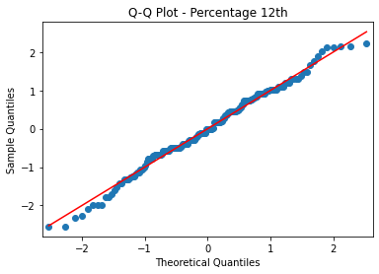
Q-Q Plot (Quantile-Quantile Plot):
Conclusion:- Based on the analysis of histograms and Q-Q plots, it can be concluded that all the continuous variables in your dataset
exhibit a normal distribution.

Slide 23
Imbalanced data:-
Imbalanced data refers to a situation where the classes in the target variable are not represented equally. One class (referred to as the majority class) is significantly more prevalent than the other classes) (referred to as the minority classes)). This can pose challenges for machine learning algorithms because they tend to be biased towards the majority class, resulting in poor performance on the minority class.
In our case the target column ‘total placed’ has two categories (‘Yes’,’No’) in responses which has count (151,23) respectively.
To tackle this problem we have used a technique of oversampling called SMOTE(Synthetic Minority Over-sampling Technique). It is a popular technique for oversampling the minority class in imbalanced datasets. It generates synthetic samples for the minority class by interpolating between existing instances. It can help to create a more balanced dataset and improve the performance of machine learning algorithms, particularly when the minority class is under-represented.
After using this technique now our target column has 151 values for both categories.

Slide 24
Feature encoding:-
Feature encoding is an essential step in preparing data for machine learning models. It involves transforming categorical or textual features into a numerical representation that can be effectively utilized by machine learning algorithms.
In our Features columns we have 22 object columns which are of nominal type so we proceeded with One Hot Encoding method.
One-Hot Encoding: It is used to represent categorical variables with multiple categories. It creates binary columns (also known as dummy variables) for each category, where a value of 1 indicates the presence of the category and 0 indicates its absence. This technique ensures that each category is represented independently, without imposing any ordinal relationship. One-hot encoding is suitable when the number of categories is relatively small.

Slide 25
Feature scaling:-
Feature scaling, also known as data normalization, is a preprocessing step used to standardize the range of feature values in a dataset. It aims to bring all features to a similar scale, removing the potential bias or dominance of certain features due to their original measurement units or scales. The main purpose of feature scaling is to ensure that the features contribute equally and fairly to the machine learning model training process.
We have used Min-Max Scaling technique for scaling the data.
Min-Max Scaling: Min-Max scaling, also known as normalization, rescales features to a specific range, typically between 0 and 1. It subtracts the minimum value of the feature and then divides by the range (maximum value minus minimum value). This technique linearly transforms the feature values to the desired range, preserving the distribution's shape.

Slide 26
feature importance (for Numeric data):
Feature importance is a concept commonly used in machine learning and statistical modeling to understand the relative importance or contribution of different input features in predicting an outcome or target variable.
The F-test is primarily suitable for selecting significant features among numeric variables. The F-test measures the linear relationship between each numeric feature and the target variable.
The variables in the table who have p-values less than 0.05 they are considered significant and the rest are considered as insignificant.
By identifying and including significant variables, the model can better capture the underlying dynamics of the data, leading to more accurate predictions and better insights.

Slide 27
Feature importance (for categorical):-
For categorical data we have used Chi-square test. It is used to assess the independence or association between two categorical variables.
The variables in the table who have p-values less than 0.05 they are considered significant and the rest are considered as insignificant.

Slide 28
Wald test:-
The Wald test is a statistical test used to assess the significance of individual coefficients (parameters) in a statistical model.
Variables | p-value
internship_Yes | 0.0009
extracurricular activities_Yes | 0.0064
work experience_Yes | 0.0072
Problem solving skills | 0.0086
leadership/Teamwork skills | 0.0107
technical/non-technical events_Yes | 0.0163
communication skills | 0.0192
Degree Specialisation_CS | 0.025
Education Status_Pursuing | 0.0273
Institute_NMIMS | 0.032
Degree Specialisation_Statistics | 0.0362
Institute_University of Mumbai | 0.0379
Degree Specialisation_Zoology | 0.0412
CGPA | 0.04738
Degree Specialisation_IT | 0.0493
Insights :-
A small p-value (typically below a chosen significance level 0.05) suggests that the coefficient is statistically significant, indicating that the predictor variable has a significant effect on the outcome.
These variables mentioned in the table are significant and have coefficients significantly different from zero, providing insights into the importance of the variable in predicting the outcome.
Thus these variables can be selected in model building.

Slide 29
Wald test:-
Variables | p-value
Father Occupation_Retired | 0.0565
Father Occupation_Self Employed | 0.0776
Annual income of family_1-3 | 0.1098
Father Occupation_Private | 0.1482
Annual income of family_above 7 | 0.1598
Degree Specialisation_Chemistry | 0.171
Institute_Somaiya University | 0.1806
Percentage 12th | 0.2239
Annual income of family_3-5 | 0.2314
Annual income of family_5-7 | 0.2464
earning members | 0.2521
Father Occupation_Medical Representative | 0.2562
members in family | 0.2815
Father Occupation_unknown | 0.2827
Father Occupation_Service | 0.3028
Father Occupation_Farmer | 0.3337
Mother Occupation_Professional | 0.3798
Religion_Sikhs | 0.4672
Institute_Mithibai | 0.4854
Mother Occupation_Housewife | 0.4854
Mother Occupation_Service | 0.4854
Type of family Nuclear | 0.4991
Mother Occupation_unknown | 0.5044
Religion_Jain | 0.5439
Religion_Hindu | 0.5739
Gender_Male | 0.5824
Degree Specialisation_Physics | 0.5824
Father Occupation_Professional | 0.5997
Father Occupation_Other | 0.6209
Mother Occupation_Farmer | 0.6663
Percentage 10th | 0.6985
Mother Occupation_Private | 0.6982
Institute_R.J.College | 0.6982
Father Occupation_Government | 0.6984
Locality_Bunglow | 0.7722
Locality_Society | 0.7824
Religion_Muslim | 0.7918
Age | 0.7923
Degree Specialisation_Maths | 0.8121
Mother Occupation_Government | 0.8439
Religion_Christian | 0.8499
Institute_Other | 0.8729
Insights:-
The following variables in the tables have p-value higher than 0.05 and thus they are insignificant variables. And thus they can be ignored for model building.

Slide 30
Splitting the data:-
We have selected significant variables in the final model obtained from the previous tests. They are as follow
Internship_Yes
Extracurricular activities_Yes
Work experience_Yes
Problem solving skills
Leadership/Teamwork skills
Technical/non-technical events_Yes
Communication skills
Degree Specialisation_CS
Education Status_Pursuing
Institute_NMIMS
Degree Specialisation_Statistics
Institute_University of Mumbai
Degree Specialisation_Zoology
CGPA
Degree Specialisation_IT
We have partitioned the whole data into two sets of data randomly using train_test_split function into partition of size 80%-20% of the whole data into train-test sets respectively.
Where the training data is used to train and tune the model for prediction and than the performance of the model is tested using the test data. This helps us in getting a better idea about the prediction power of our model.
After partition the size of two data sets is :-
Training data set
size of x_train is : (241, 15)
size of y_train is : (241, 1)
Test data set
size of x_test is :(61, 15)
size of y_test is :(61, 1)

Slide 31
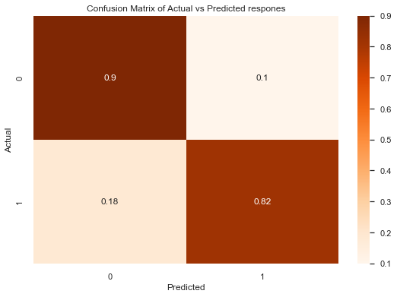
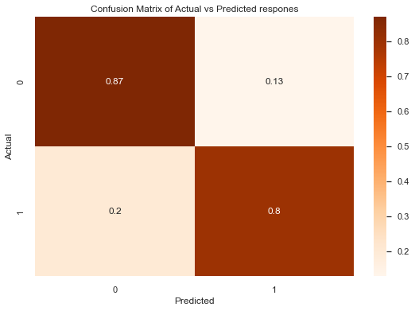
Development of a model :-
Logistic Regression Model :-
A logistic model, also known as logistic regression, is a statistical model used to analyze the relationship between a binary or categorical dependent variable and one or more independent variables, it is a regression model that estimates the probability of an event occurring based on input features.
After fitting model we get following output :-
From train data :-
accuracy score: 0.976923076923 recall score: 0.99115044247787 precision score: 0.98245614035
From test data :-
accuracy score: 0.840909090909 recall score: 0.94736842105263 precision score: 0.878048780487

Slide 32
Logistic regression model:-
The Logistic regression model fitted using coefficients and variable is as follow:-
y = 1 / (1 + exp(-(0.3982 + internship_Yes * 0.8641 + extracurricular activities_Yes * 0.1858
+ work experience_Yes * 0.7525 + Problem solving skills * 0.5413 + leadership/Teamwork skills * 0.4077
+ technical/non-technical events_Yes * 0.3443 + communication skills * -0.2575
+ Degree Specialisation_CS * 0.9284 + Education Status_Pursuing * -0.5422 + Institute_NMIMS * 0.9226
+ Degree Specialisation_Statistics * 1.0468 + Institute_University of Mumbai * 0.7247
+ Degree Specialisation_Zoology * -0.3356 + CGPA * -0.2222 + Degree Specialisation_IT * 0.3520)))

Slide 33
Odds ratio :-
The odds ratio is a measure of the association or relationship between two variables in a study. It quantifies the odds of an event occurring in one group relative to the odds of the event occurring in another group.
Insights :-
Here we can see that those who have internships have 2.3 times more odds of getting placed compared to not having internship.
Similarly, for other variables like extracurricular activities, Problem solving skills, communicating skills, team work skills Degree specialization have odds ratio greater than 1.4 indicating a significant positive relationship with the target outcome.
While CGPA with 1.1 odds ratio suggesting indicating a modest positive association with the target outcome.
Variables with value less than 1 indicates modest negative association with the target outcome.

Slide 34
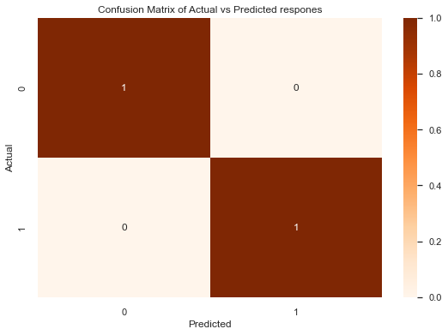
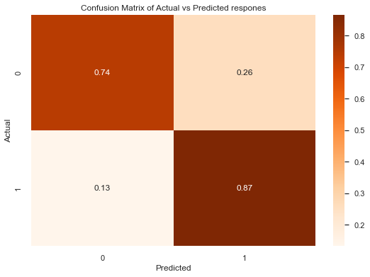
Decision Tree Model :-
The Decision Tree algorithm is a popular supervised machine learning model used for both classification and regression tasks.
It is a tree-like structure that recursively partitions the data based on feature conditions to make predictions.
After fitting model we get following output :-
From train data:-
From test data :-
accuracy score: 1.0
recall score: 1.0
precision score: 1.0
accuracy score:0.78688524
recall score:0.7
precision score:0.84

Slide 35

Random Forest Model :-
Random Forest is a popular ensemble machine learning algorithm that combines the predictions of multiple decision trees to make accurate predictions.
It is known for its robustness, versatility, and ability to handle complex data.
After fitting model we get following output :-
From Train data :-
From Test data:-
accuracy score: 1.0
recall score: 1.0
precision score: 1.0
accuracy score: 0.91803278
recall score: 0.9
precision score:0.931034427

Slide 36
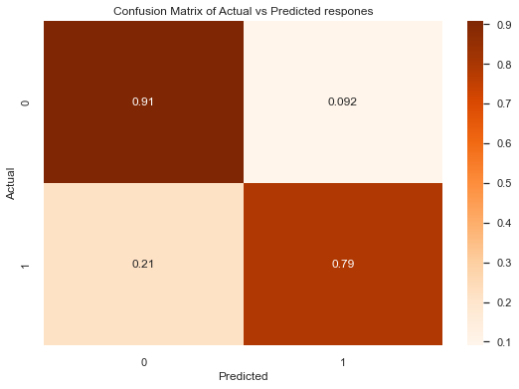
Support Vector Machine (SVM) Model :-
Support Vector Machine (SVM) is a powerful supervised machine learning algorithm used for both classification and regression tasks.
It is widely known for its ability to handle complex data and high-dimensional feature spaces.
After fitting model we get following output :-
From train data :-
From test data:-
accuracy score: 0.83817427
recall score: 0.7933884
precision score: 0.7272727
accuracy score: 0.83606557
recall score: 0.8
precision score:0.857142857

Slide 37
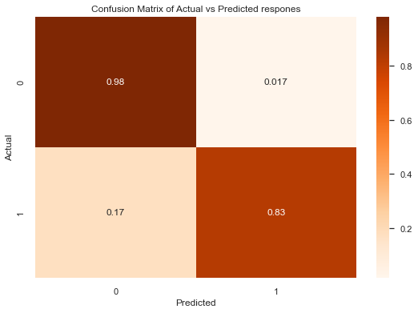
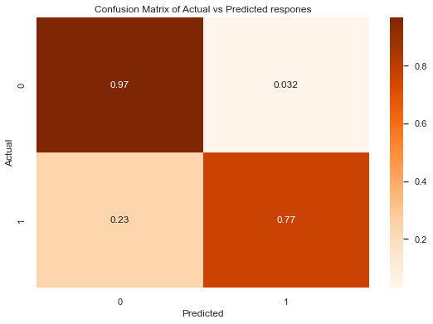
K-Nearest Neighbors (KNN) Classification Model :-
The K-Nearest Neighbors (KNN) algorithm is a simple and intuitive supervised machine learning model used for classification tasks.
It predicts the class of a new data point based on the classes of its k nearest neighbors in the feature space.
After fitting model we get following output :-
From train data :-
From test data :-
accuracy score: 0.9170712448
recall score: 0.8677685950
precision score: 0.96330275
accuracy score: 0.83606557377
recall score: 0.766666667
precision score: 0.88461538

Slide 38
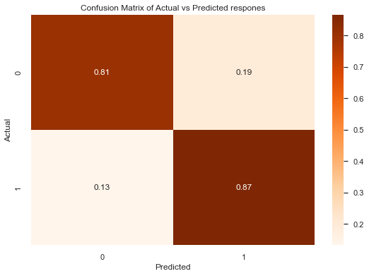
XGBoost Model :-
XGBoost (Extreme Gradient Boosting) is a powerful machine learning algorithm known for its effectiveness in handling structured data and a wide range of tasks.
It belongs to the family of gradient boosting algorithms and has gained popularity due to its exceptional performance in various machine learning competitions.
After fitting model we get following output :-
From train data:-
From test data :-
accuracy score: 1.0
recall score: 1.0
precision score: 1.0
accuracy score: 0.8524590
recall score: 0.8
precision score: 0.888888888

Slide 39
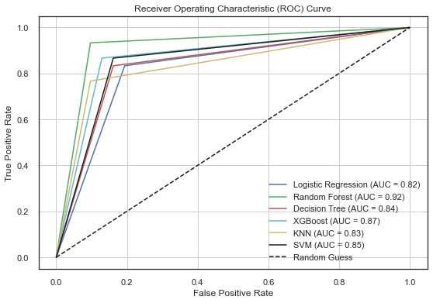
ROC AUC curve:-
The ROC AUC curve is a powerful tool for visually assessing and comparing the performance of binary classification models. Each point on the curve represents a different threshold, and the curve provides an overall visualization of the model's performance across all possible thresholds.
Here's a summary of the AUC values for the models:
Logistic Regression: AUC = 0.82
Decision Tree: AUC = 0.84
Random Forest: AUC = 0.92
XGBoost: AUC = 0.87
KNN: AUC = 0.83
SVM: AUC = 0.85
The AUC values indicate the models' ability to
distinguish between the positive and negative classes,
with higher values representing better performance.
In this case, the Random Forest model has the highest
AUC of 0.92, followed by XGBoost, SVM, Decision Tree, Logistic Regression, and KNN.

Slide 40
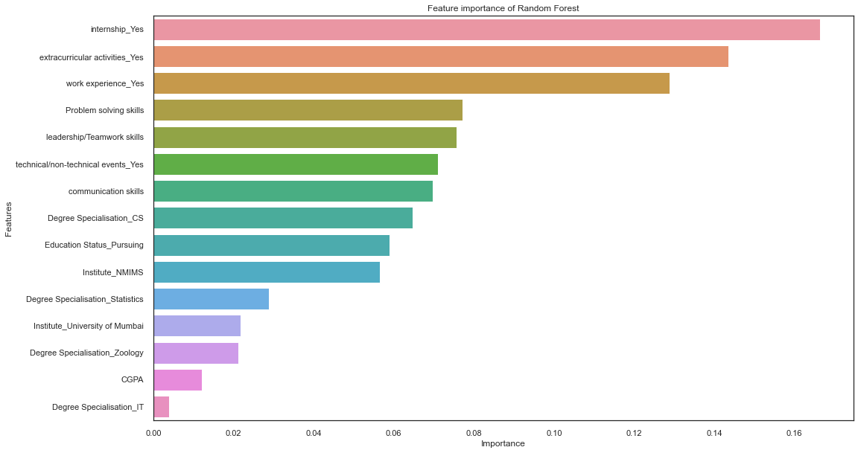
Feature importance from Random Forest:-
Insights:-
Here we can see the importance of each & every feature in our final Random Forest model.
The variable internship has the highest importance followed by extracurricular activities , work experience, problem solving skills and so on .

Slide 41
performance Comparison of all models:-
Here our top 3 models With highest test accuracy are
Random Forest Classifier, XGBoost Classifier & Logistic
Regression. And the Best performing model is Random
Forest Classifier with 91% test accuracy.

Slide 42
Conclusion:-
On fitting the above models on the data, we observed that the Random Forest model does a good job in predicting an individuals placement on the basis of accuracy and AUC Curve 91% & 92% respectively
Hence it is a good classifier model from all the above models
Internship has a significant association with an individuals placement.
From our analysis, Work experience, Communication Skills, Problem solving skills, Leadership/Teamwork Skills, Degree specialisation etc. plays an crucial role for an individual getting placed
Placement prediction project provide organizations as well as an individual with valuable insights into important factors for placement. By analyzing relevant factors and historical data, these projects can enhance the decision-making process and improve the efficiency of the hiring process.
From the study we can say that organizations give more preference to the candidates with internship/work experience. So candidates and Institutes should emphasize on internships for increasing the probability of job placement.

Slide 43
THANK YOU

